Slide 1
OGC API DGGS - Background
Robert Gibb
Matt Purss
119th OGC Member Meeting
Virtual | 16 June 2021

Slide 2
DGGS as Reference Systems
DGGS Abstract Specification 21 v2.0 Discrete Global Grid Systems
.. V2.0 is approved and in the OGC publication pipeline .. also published as ISO 19170-1
Defines DGGS in terms of a Reference System using Zonal Identifiers with Structured Geometry
DGGS RS may be 2D, 3D or 4D
Zonal Identifers are identifiers that are recognised as spatial/spatio-temporal because they
support a set of topological query operations that are defined in the specification
Today we are focusing on these topological query operations from an OGC API DGGS perspective
Notes:
No such thing as WGS84 data. Because WGS84 and feature geometry are independent. Data uses WGS84. WGS as shapefile or GeoJSON.
Within a DGGS a geometry is never explicitly provided as coordinates, and therefore does not need to be encoded in a traditional spatial data format.

Slide 3
DGGS – From DGGS Reference system to DGGS data
No
Yes
There is no WGS84 data or UTM 3 data.
Traditional RS are independent of the choice of feature geometry and (spatial) data format.
DGGS Reference Systems define their own geometry.
Geometry is implied by ZoneID, i.e., an identifier.
It’s the DGGS RS’s Navigator functions that “make these identifiers spatial”.
complexity
simplicity
Notes:
No such thing as WGS84 data. Because WGS84 and feature geometry are independent. Data uses WGS84. WGS as shapefile or GeoJSON.
Within a DGGS a geometry is never explicitly provided as coordinates, and therefore does not need to be encoded in a traditional spatial data format.

Slide 4
DGGS – DGGS data – WKT type structure
List of ZoneIDs |  | Directed Lists of ZoneIDs
Type | Examples | Type | Examples
OrdinateList set of nD points | POINT, MULTIPOINT | DirectedOrdinateList nD line vertices | LINESTRING, POLYGON (boundary), TRIANGLE, route, trajectory, timeseries
CellList set of nD regions or spaces | POINT, MULTIPOINT, POLYGON, MULTIPOLYGON, point cloud, raster or WMS image, geo-located social media | DirectedCellList nD connected path | route, trajectory, timeseries
TileList set of tiles or ‘b-box’ | TileSet, DB shard, b-box, jobqueue | DirectedTileList sequence of ‘bbox’ | ordered jobqueue
ZoneCollection collection of other type(s) | MULTILINESTRING, GEOMETRYCOLLECTION | DirectedZoneCollection graph or connected collection of similar or different type(s) | TIN, network (of DirectedOrdinateList or DirectedCellList)
optional | sort by decreasing size, compress

Slide 5
DGGS – OGC API defined and implemented
Implementations
OGC API-Processes
OGC API-Features
DGGS Client
Services present DGGS RS as collection of
virtual vector layers.
Each layer (item in the collection) corresponds to a level of the DGGS RS grid hierarchy.
Clients can request:
either
JSON (with just ZoneIDs)
or
GeoJSON (with ZoneIDs augmented with coordinates created on-the-fly).
.
Geoserver implementation of OGC API-Processes
Single wrapper library was created to deliver both H3 and rHEALPix, as virtual vector layers.
All of Geoserver functionality provided to DGGS. Allowed exposing WMS and WFS to clients as a BONUS
Attached to a backend DGGS Datastore with ZoneID as primary index for Sentinel-2 pixel in a No-SQL DB.
Proved very fast for both Sentinel-2 data, statistics, and index calculations.
Implemented Linked Data approach with an RDF data store. Very successful, results feeding into GeoSPARQL revision. Vector data for Australia’s Level 1 Statistical Meshblocks and Hydrological Catchments were converted to DGGS RDF data with the DGGS ZoneID as the predicate (i.e., primary index) for the data.
The OGC API - Features end-point presented this data as either JSON LD - using the DGGS ZoneID as the only representation of geometry, or as GeoJSON
Native DGGS Mapping Clients built to consume and overlay OGC API-Features and OGC API Processes.
Desktop and Jupyter Notebook clients created.
Participants delivered native DGGS vector and EO capabilities to users of both traditional GIS clients and native DGGS clients.
Showing versatility of DGGS as a chameleon.

Slide 6
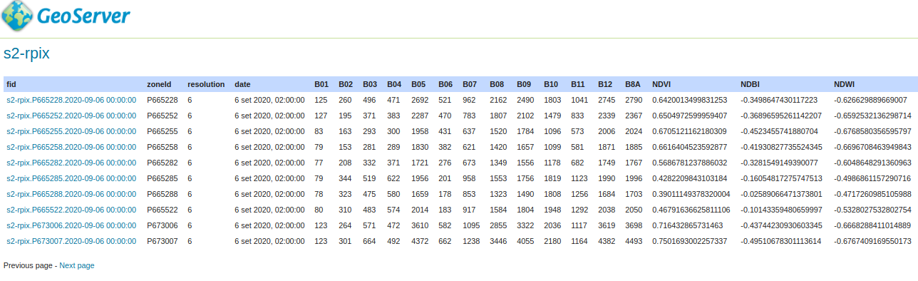
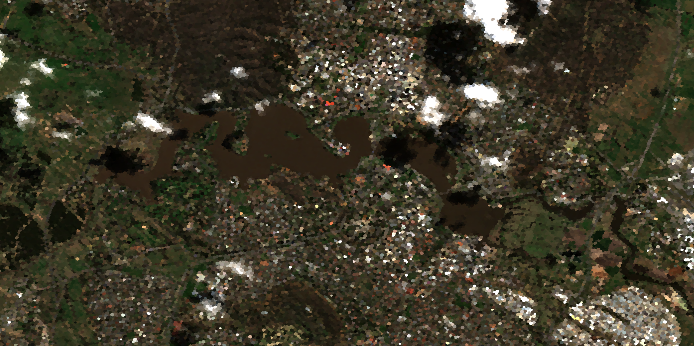
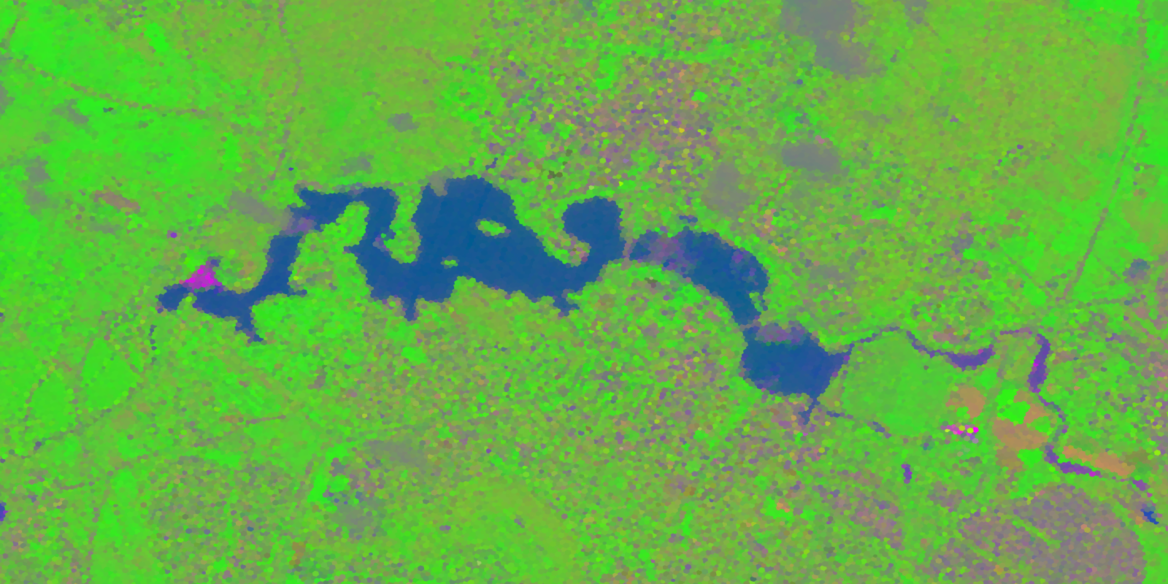
OGC API Processes results with Sentinel 2
Sentinel 2: B04, B03, B02 & NDBI, NDVI, NDWI

Slide 7
DGGS APIs – Tested Constructs
DGGS-Powered COLLECTIONS
(OGC API - Common)
{datasetAPI}/collections/{collectionId}
(OGC API - Features)
{datasetAPI}/collections/{collectionId}/items
(Features API benefitting from DGGS power)
(OGC API - Coverages)
{datasetAPI}/collections/{collectionId}/coverage
(Coverages API benefitting from DGGS power)

Slide 8
DGGS APIs – Tested Constructs
[DGGS API - Core]
Conformance Class "Core"
COLLECTION DGGS DATA ACCESS
{datasetAPI}/collections/{collectionId}/dggs
{datasetAPI}/collections/{collectionId}/dggs/{dggsId}
{datasetAPI}/collections/{collectionId}/dggs/{dggsId}/zones

Slide 9
DGGS APIs – Tested Constructs
[DGGS API - Core]
Conformance Class "DGGS Zone Data" - (What is here?)
{datasetAPI}/collections/{collectionId}/dggs/{dggsId}/zones/{zoneId}
[returns actual data, e.g. Zarr / Xarray, GeoJSON]
Conformance Class "List Data Zones" - (Where is it?)
(virtual (processing results) or data collection)
{datasetAPI}/collections/{collectionId}/dggs/{dggsId}/zones/listZonesWithData/{hierarchyLevel}[?bbox=]
(which zones have data at this level?)

Slide 10
DGGS APIs – Tested Constructs
[DGGS API - Core]
Conformance Class “DGGS Structure"
{datasetAPI}/dggs
{datasetAPI}/dggs/{dggsId}
information about the DGGS (hierarchy levels, zones etc.)
{datasetAPI}/dggs/{dggsId}/zones
{datasetAPI}/dggs/{dggsId}/zones/{zoneId}
[links for child, parent, sibling zones]

Slide 11
DGGS APIs – Tested Constructs
[DGGS API - Core]
Conformance Class "Topological Zone relationships"
{datasetAPI}/dggs/{dggsId}/zones/{zoneId}/children?zone={id} => child?another={zoneId}…
{datasetAPI}/dggs/{dggsId}/zones/{zoneId}/parents?zone={id} => parent?another={zoneId}…
{datasetAPI}/dggs/{dggsId}/zones/{zoneId}/neighbours?zone={id} ≅> sibling?another={zoneId}…
Conformance Class "Zones as Features"
{datasetAPI}/dggs/{dggsId}/features/ (landing page)
{datasetAPI}/dggs/{dggsId}/features/collections/
{datasetAPI}/dggs/{dggsId}/features/collections/{zoneId}
{datasetAPI}/dggs/{dggsId}/features/collections/{zoneId}/items (zone polygons)

Slide 12
OGC API DGGS
OGC Abstract Specification 21 v 2.0 DGGS: https://github.com/opengeospatial/ogcapi-discrete-global-grid-systems/blob/master/20-040r3-OGC-AS21-DGGSv2.0-draft-19170-1-proof.pdf c.f. section 8.3.3. Core Topological Query Functions module
Defines ZoneQuery operations which are redefined from Query2D and Query 3D ISO 19107:2019 Spatial Schema – these are DE9IM operations: within, crosses, union etc – and augmented by temporal and hierarchical topological operators.
Three critical differences are introduced in ZoneQuery:
Geometries in ZoneQuery are represented by Zonal Identifiers, rather than by sets of coordinates in Query2D and Query3D,
A single set of operations now cover 1D, 2D, 3D & 4D topological queries, this is achieved through a projectTo parameter, which constrains the dimensionality of the operation.
The operations are all defined as topological comparisons between two individual zones, rather than two features. With DGGS all features are represented by lists of Zonal Identifiers. Features can be compared topologically by applying the zone level comparisons to members in the list.

Slide 13
DGGS – RS Navigator: topological functions on ZoneID
distance (another:ZonalIdentifier, projectTo:DirectPosition[4])
<<query>> contains (another:ZonalIdentifier, projectTo:DirectPosition[4])
crosses (another:ZonalIdentifier, projectTo:DirectPosition[4])
disjoint (another:ZonalIdentifier, projectTo:DirectPosition[4])
equals (another:ZonalIdentifier, projectTo:DirectPosition[4])
intersects (another:ZonalIdentifier,projectTo:DirectPosition[4])
overlaps (another:ZonalIdentifier, projectTo:DirectPosition[4])
touches (another:ZonalIdentifier, projectTo:DirectPosition[4])
within (another:ZonalIdentifier, projectTo:DirectPosition[4])
withinDistance(another:ZonalIdentifier, dist:Distance, projectTo:DirectPosition[4])
parentOf (another:ZonalIdentifier, inheritID:Boolean, projectTo:DirectPosition[4])
childOf (another:ZonalIdentifier, inheritID:Boolean, projectTo:DirectPosition[4])
siblingOf (another:ZonalIdentifier, inheritID:Boolean, projectTo:DirectPosition[4])
<<query>> (1D) relativePosition(another:ZonalIdentifier, projectTo:DirectPosition[4])
<<reference>> relate (another:ZonalIdentifier, matrix:CharacterString, projectTo:DirectPosition[4])
<<reference>> (1D) relatePosition(another:ZonalIdentifier, relate:RelativePosition, projectTo:DirectPosition[4])
<<set>> buffer (dist:Distance, projectTo:DirectPosition[4])
difference (another:ZonalIdentifier, rangeRefine:refinementLevelRange, projectTo:DirectPosition[4])
intersection (another:ZonalIdentifier, rangeRefine:refinementLevelRange, projectTo:DirectPosition[4])
symDifference(another:ZonalIdentifier, rangeRefine:refinementLevelRange, projectTo:DirectPosition[4])
union (another:ZonalIdentifier, rangeRefine:refinementLevelRange, projectTo:DirectPosition[4])
parent (inheritID:Boolean, levels:Integer, projectTo:DirectPosition[4])
child (inheritID:Boolean, levels:Integer, projectTo:DirectPosition[4])
sibling (inheritID:Boolean, levels:Integer, projectTo:DirectPosition[4])

Slide 14
DGGS – RS Navigator: topological function parameters
another:ZonalIdentifier Specifies the target region for the query. In zonal query a zone's identifier provides (Mandatory) suﬀicient description of its topology. ZonalIdentifier takes the place of the geometry data used in Query2D and Query3D for both the source and the target.
projectTo:DirectPosition[4] projectTo specifies an optional reference direction, surface or volume for an operation.
(Optional, default:(1,1,1,1) ) Allowed values for each direction are {0,1,n}. projectTo takes one of three forms:
1D: In its one-dimensional form for specifying a reference direction,
only one direction has a value of 1. For example, (0,0,0,1) projects to the temporal axis, and (0,0,1,0) projects
to the vertical axis. Only the 1D form is supported by relativePosition and
relatePosition, default (0,0,0,1).
2D: In its two-dimensional form for specifying a reference surface, two directions have a
value of 1. For example, a surface at height n is specified by a projectTo value of (1,1,n,0)
representing the vector [(0,0,n,0),(1,1,n,0)].
3D: In its three-dimensional form for specifying a reference volume, three directions have
a value of 1. For example, (1,1,1,0) projects to a spatial volume without reference to time, and (1,1,n,1) projects to a surface spanning all time at height n.

Slide 15
DGGS – RS Navigator: topological functions parameters (cont)
rangeRefine:refinementLevelRange Specifies the range of refinement levels to include in a return <<set>>. (Optional, default: [min:max]) The integers representing the lower and upper bounds in the refinementLevelRange
datatype are both included in the range.
levels:Integer Levels indicates the relative number of levels in the hierarchy to be traversed in (Optional, default:1) assembling a result <<set>>
inheritID:Boolean When inheritID has a value of True the result <<set>> only contains cells for which the
(Optional, default:False) IDs have shared inheritance, and a value of False indicates that inheritance is ignored.
dist:Distance a distance measure with units.
(Mandatory)
matrix:CharacterString 3x3 intersection matrix of DE-9IM string codes with values {0,1,2,3,F,*}
(Mandatory)
relate:RelativePosition a RelativePosition enumeration as defined in W3C/OGC 16-071r3 as one of: (Mandatory) {Before, After, Meets, MetBy, Overlaps, OverlappedBy, Starts, StartedBy,
During, Contains, Finishes, FinishedBy, Equals, In, Disjoint}

Slide 16
OGC API DGGS - Background
Robert Gibb
119th OGC Member Meeting
Virtual | 16 June 2021

Slide 17
OGC API DGGS
The DGGS Abstract Specification 21 v2.0 contains definitions for a suite of 4D topological operations that we are going to represent in SwaggerHub as an OpenAPI description.
Practical work step 1: Describing OGC API – DGGS DE9IM <<query>> parameters in YAML
Practical work step 2: Describing OGC API – DGGS DE9IM <<query>> operations in YAML
Practical work step 3: Describing OGC API – DGGS DE9IM <<set>> operations in YAML
Practical work step 4: Describing OGC API – DGGS <<reference>> and other operations in YAML

Slide 18
OGC API DGGS: Dev Resources
Abstract Specification: https://github.com/opengeospatial/ogcapi-discrete-global-grid-systems/blob/master/20-040r3-OGC-AS21-DGGSv2.0-draft-19170-1-proof.pdf c.f. section 8.3.3. Core Topological Query Functions module
TB-16 OGC API – DGGS-Process: https://app.swaggerhub.com/apis/aaime-sh/dggs-process/0.0.3 this is going to be our starting point, it implements many contextual functions for DGGS, but only 2x of the 24x operations specified in section 8.3.3 are defined, and only in their 2D form.
GitHub: https://github.com/opengeospatial/ogcapi-discrete-global-grid-systems This is where the YAML file we will be working in is stored.
2021-06-16 Developer Track – OGC API DGGS: https://app.swaggerhub.com/apis/rggibb/dggs-zonequery/0.0.4 This is the test space for our YAML file.

Slide 19
Requirements
Familiarity with git (clone, etc.)
Familiarity with github
Familiarity with YAML, but we will introduce you to YAML
We have a starting YAML file: https://github.com/opengeospatial/ogcapi-discrete-global-grid-systems/blob/master/dggs-zonequery.yml
So if you would like to open it …

Slide 20
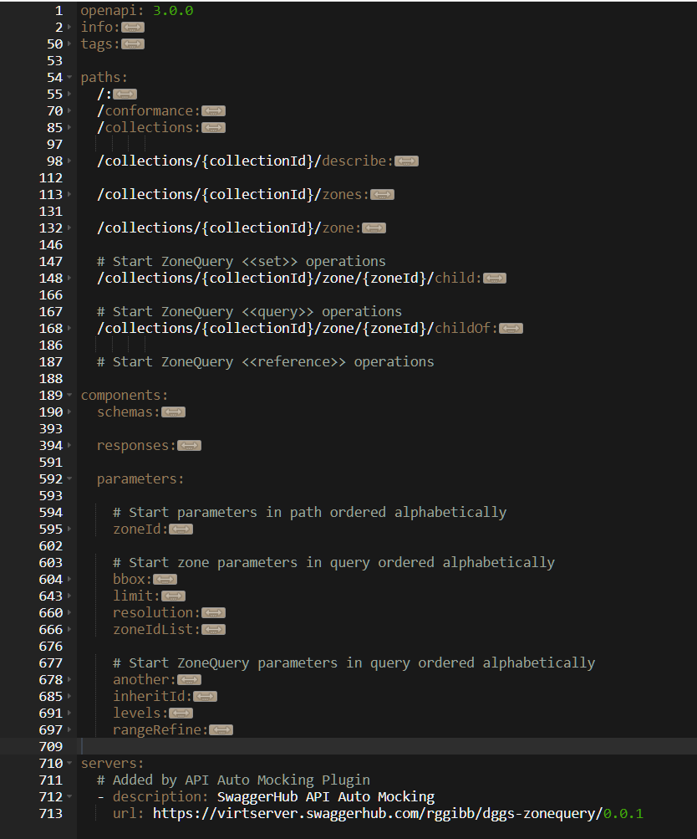
OGC API – DGGS DE9IM <<query>> operations in YAML
YAML file structure:
Step 3
Step 1
Step 2
Step 4

Slide 21

OGC API DGGS <<query>>
OGC API DGGS parameters
#OGCAPI

Slide 22
DGGS – RS Navigator: topological function parameters
another:ZonalIdentifier Specifies the target region for the query. In zonal query a zone's identifier provides (Mandatory) suﬀicient description of its topology. ZonalIdentifier takes the place of the geometry data used in Query2D and Query3D for both the source and the target.
projectTo:DirectPosition[4] projectTo specifies an optional reference direction, surface or volume for an operation.
(Optional, default:(1,1,1,1) ) Allowed values for each direction are {0,1,n}. projectTo takes one of three forms:
1D: A one-dimensional form for specifying a reference direction,
only one direction has a value of 1. For example, (0,0,0,1) projects to the temporal axis, and (0,0,1,0) projects
to the vertical axis. Only the 1D form is supported by relativePosition and
relatePosition, default (0,0,0,1).
2D: A two-dimensional form for specifying a reference surface,
two directions have a value of 1. For example, a surface at height n is specified by a projectTo value of (1,1,n,0)
representing the vector [(0,0,n,0),(1,1,n,0)].
3D: A three-dimensional form for specifying a reference volume,
three directions have a value of 1. For example, (1,1,1,0) projects to a spatial volume without reference to time, and (1,1,n,1) projects to a surface spanning all time at height n.
started

Slide 23
DGGS – RS Navigator: topological functions parameters (cont)
rangeRefine:refinementLevelRange Specifies the range of refinement levels to include in a return <<set>>. (Optional, default: [min:max]) The integers representing the lower and upper bounds in the refinementLevelRange
datatype are both included in the range.
levels:Integer Levels indicates the relative number of levels in the hierarchy to be traversed in (Optional, default:1) assembling a result <<set>>
inheritID:Boolean When inheritID has a value of True the result <<set>> only contains cells for which the
(Optional, default:False) IDs have shared inheritance, and a value of False indicates that inheritance is ignored.
dist:Distance a distance measure with units.
(Mandatory)
matrix:CharacterString 3x3 intersection matrix of DE-9IM string codes with values {0,1,2,3,F,*}
(Mandatory)
relate:RelativePosition a RelativePosition enumeration as defined in W3C/OGC 16-071r3 as one of: (Mandatory) {Before, After, Meets, MetBy, Overlaps, OverlappedBy, Starts, StartedBy,
During, Contains, Finishes, FinishedBy, Equals, In, Disjoint}
started
started
started

Slide 24
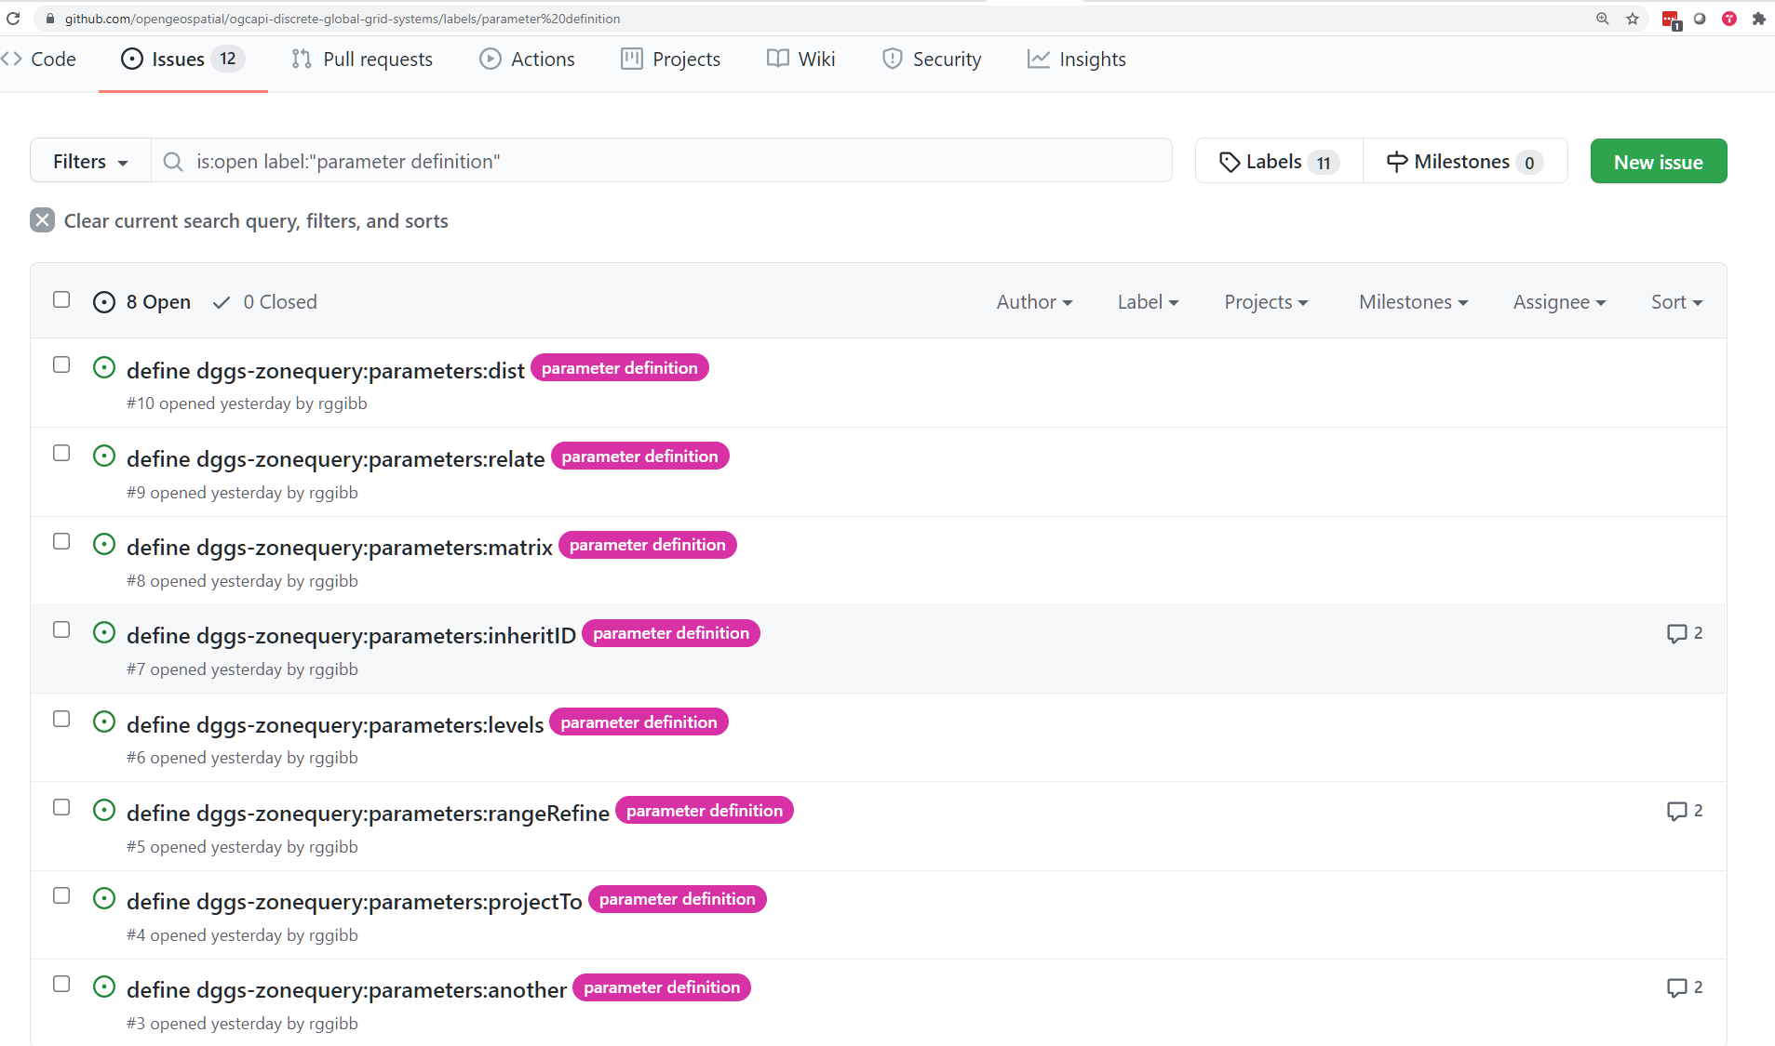
DGGS – RS Navigator: topological functions parameters (cont)

Slide 25
OGC API – DGGS DE9IM <<query>> operations in YAML
YAML file structure:
Step 1

Slide 26
OGC API DGGS <<query>>
OGC API DGGS <<query>>
#OGCAPI

Slide 27
OGC API – DGGS DE9IM <<query>> operations in YAML
Overview
DE9IM <<query>> are: contains, crosses, disjoint, equals, intersects, overlaps, touches, within, withinDistance, relativePosition parentOf, childOf, siblingOf
General pattern: /zone/{ZonalIdentifier}/{query}?another=ZonalIdentifier&projectTo=DirectPosition[4] return True|False
Variations: /zone/{ZonalIdentifier}/parentOf | childOf | siblingOf?another=ZonalIdentifier&inheritID:Boolean &projectTo:DirectPosition[4] return True|False /zone/{ZonalIdentifier}/withinDistance?another=ZonalIdentifier&dist:Distance&projectTo:DirectPosition[4] return True|False /zone/{ZonalIdentifier}/relativePosition?another=ZonalIdentifier&projectTo:DirectPosition[4] return RelativePosition where RelativePosition:{Before, After, Meets, MetBy, Overlaps, OverlappedBy, Starts, StartedBy, During, Contains, Finishes, FinishedBy, Equals, In, Disjoint}

Slide 28
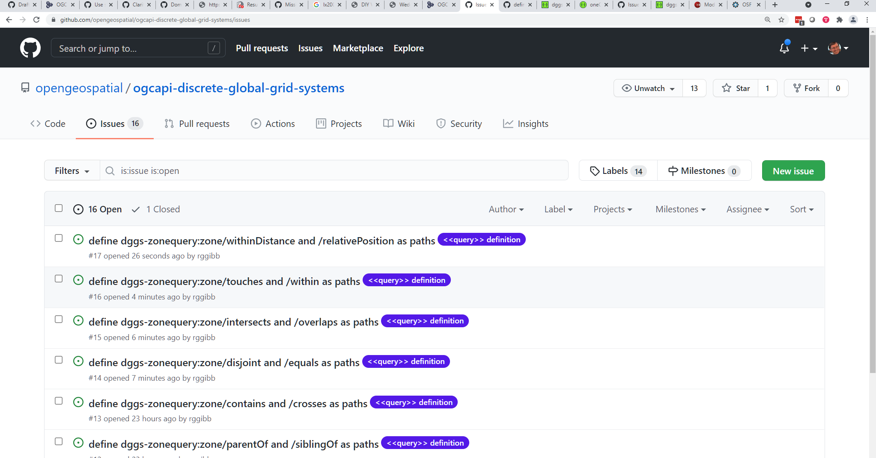
OGC API – DGGS DE9IM <<query>> operations in YAML

Slide 29
OGC API – DGGS DE9IM <<query>> operations in YAML
YAML file structure:
Step 2

Slide 30
OGC API DGGS <<set>>
OGC API DGGS
<<set>>
#OGCAPI

Slide 31
OGC API – DGGS DE9IM <<set>> operations in YAML
Overview
DE9IM <<set>> operations are: buffer, difference, intersection, symDifference, union parent, child, sibling
General pattern: /zone/{ZonalIdentifier}/<<set>>?another=ZonalIdentifier,rangeRefine=refinementLevelRange&projectTo=DirectPosition[4] return zoneIdList where refinementLevelRange is [maxRefinementLevel:minRefinementLevel]
Variations: /zone/{ZonalIdentifier}/parent | child | sibling?levels=Integer&inheritID=Boolean&projectTo=DirectPosition[4] return zoneIdList /zone/{ZonalIdentifier}/buffer?dist=Distance&projectTo=DirectPosition[4]), return zoneIdList

Slide 32
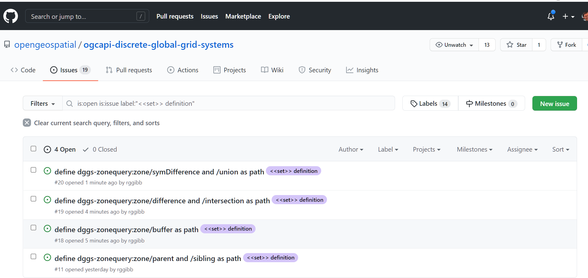
OGC API – DGGS DE9IM <<set>> operations in YAML

Slide 33
OGC API – DGGS DE9IM <<set>> operations in YAML
YAML file structure:
Step 3

Slide 34
OGC API DGGS <<reference>> etc
OGC API DGGS
<<reference>> etc
#OGCAPI

Slide 35
OGC API – DGGS DE9IM <<reference>> and other operations in YAML
Overview
DE9IM <<reference>> operations are: relate, relatePosition
Variations: /zone/{ZonalIdentifier}/relate?another=ZonalIdentifier&matrix=CharacterString&projectTo:DirectPosition[4]) return True|False /zone/{ZonalIdentifier}/relativePosition?another=ZonalIdentifier&relate=RelativePosition&projectTo:DirectPosition[4]) return True|False
other operation: distance
General pattern: /zone/{ZonalIdentifier}/distance?another=ZonalIdentifier&projectTo=DirectPosition[4]) return Distance

Slide 36
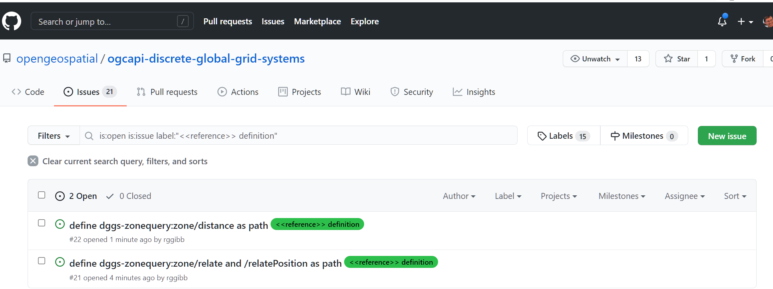
OGC API – DGGS DE9IM <<reference>> operations in YAML

Slide 37
OGC API – DGGS DE9IM <<reference>> operations in YAML
YAML file structure:
Step 4

